Slide 1
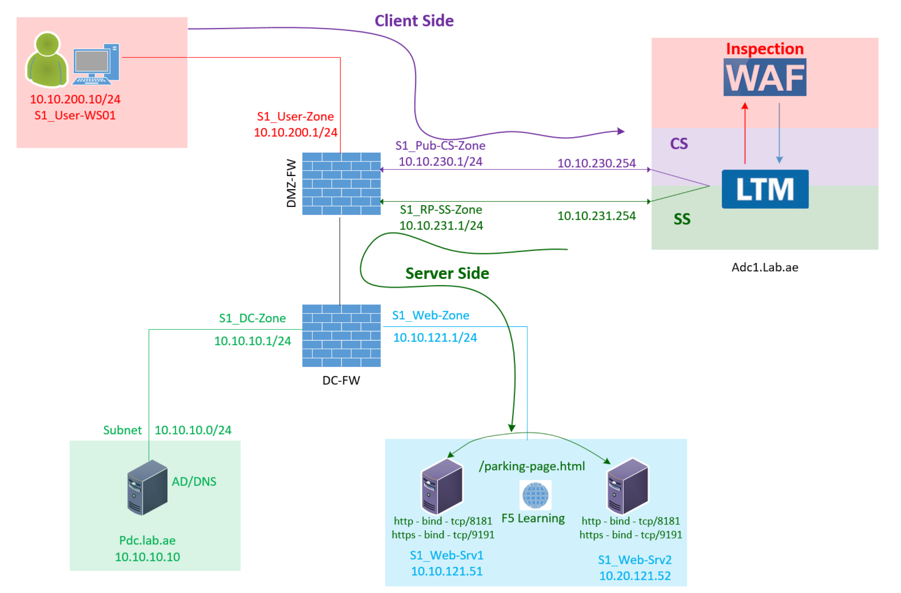

F5 LTM Learning with Alexander S
Chapter 05 – Understand the concepts of Nodes, Pools, Pool Members and Health Monitors

Slide 2
Chapter 05 – Understand the concept of Nodes, Pools, Pool Members and Health Monitors
Step 01: What is a Node in F5?
Step 02: What is pool and pool members in F5?
Step 03: What is Health Monitor in F5?

Slide 3
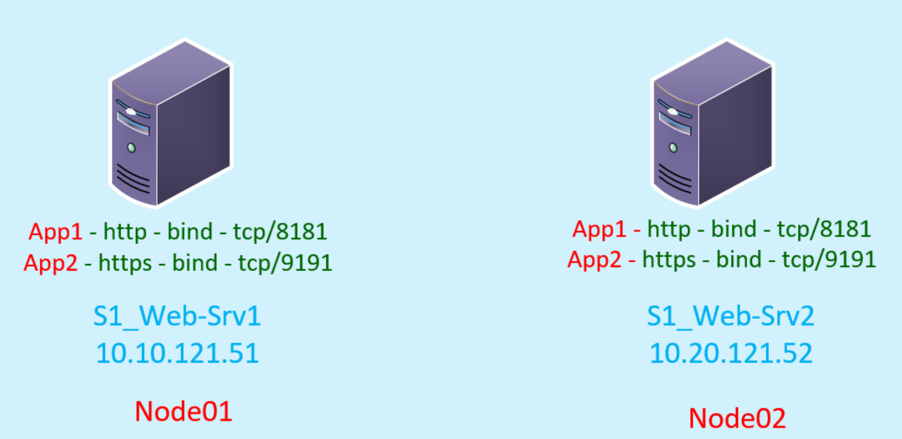
Step 01 : What is a Node in F5?
Node is a web server.
Server hosting the web application using a specific TCP port is called a node.
A node can host a single or multiple web applications.

Slide 4
Step 01 : What is a Node in F5?
(Node can host morn than one applications)
Each node is hosting two web applications.
The first (HTTP) web application is hosted on TCP port 8181.
The second (HTTPS) web application is hosted on TCP port 9191.
The same application running in both the nodes for redundancy and load balancing.

Slide 5
Step 02: What is pool and pool members?
(Dynamic Load Balancing Algorithms)
Load Balancing
(dynamic load balancing algorithms)
Round robin /Least connections
Configured the same web application using two nodes for redundancy and load balancing
F5 does the load balancing between multiple nodes using dynamic load balancing algorithm like round robin, least connections
Learning Portal Https

Slide 6
Step 02: What is pool and pool members?
Pool:
For load balancing, we group the same type of web application instances into a single group.
In F5, this group is called a Pool.
Pool Member:
Each application instance running on a server (IP address and port) becomes a pool member.
Application instance is nothing but a port number binded to a web application.
Learning-Portal-Http-Pool: The Learning Portal HTTP application instance is configured on two nodes:
Web-srv01 and Web-srv02, using TCP port 8181.
Let us group this as the Learning-Portal_Http pool.
Learning-Portal-Https-Pool: The Learning Portal HTTPS application instance is configured on the same two nodes:
Web-srv01 and Web-srv02, using TCP port 9191.
Let us group this as the Learning-Portal_Https pool.
Pool 1 → Web App 1
Node1:8181
Node2:8181
Pool 2 → Web App 2
Node1:9191
Node2:9191
Group 01 = Pool 1
(http app)
Instance
Member
Instance
Member
Group 02 = Pool 2
(https app)
Instance
Member
Instance
Member
Pool 1 → Learning-Portal_Http
S1_Web-Srv01:8181
S1_Web-Srv02:8181
Pool 2 → Learning-Portal_Https
S1_Web-Srv01:9191
S1_Web-Srv02:9191

Slide 7
Step 03: Health Monitors
F5 sends the HTTP web requests to the backend server only after checking the web service availability.
A health monitor is an automatic check performed by the F5 load balancer to make sure a web application is working correctly on the web server.

Slide 8
Step 03: Health Monitors
Pool 1 → Learning-Portal_Http
(Pool 1 attached with http health monitor)
S1_Web-Srv01:8181
S1_Web-Srv02:8181
Pool 2 → Learning-Portal_Https
(Pool 2 attached with https health monitor)
S1_Web-Srv01:9191
S1_Web-Srv02:9191

Slide 9
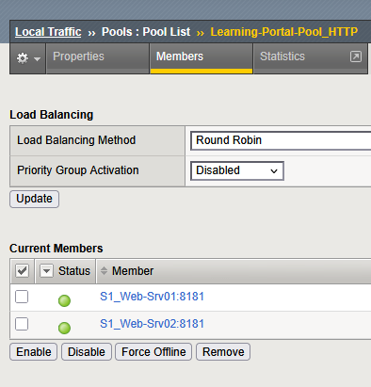
Step 03: Health Monitors
(Status - Available)
Health Monitor Assigned / Web Server Instance 8181 Response is Good

Slide 10
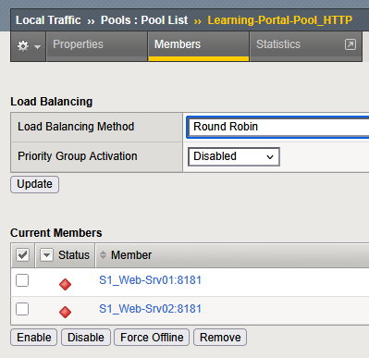
Step 03: Health Monitors
(Status - Unavailable)
Health Monitor Assigned / Web Server Instance 8181 Response is Error or No Response

Slide 11
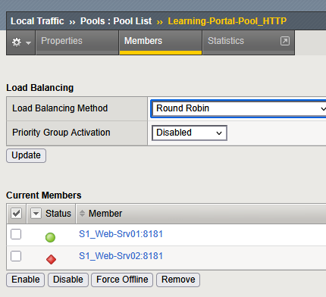
Step 03: Health Monitors
(Member Status – Based on health monitor response)
Member Status – Based on health monitor response

Slide 12
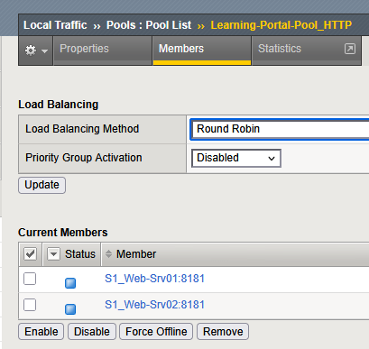
Step 03: Health Monitors
What if do not attach the health monitor to the pool?
F5 will not monitor the pool member status
(Status - Unknown)
Health Monitor Not assigned /
Web server Instance 8181 Response is Unknown

Slide 13
Step 03: Health Monitors
(Status Unknown/Available/Unavailable)
Health Monitor Not assigned /
Web server Instance 8181 Response is Unknown
Health Monitor Assigned / Web Server Instance 8181 Response is Good
Health Monitor Assigned / Web Server Instance 8181 Response is Error or No Response
Does the F5 monitor only web application?
F5 Can monitor anything from Layer 3 to Layer 7

Slide 14
Step 03: Health Monitors
(Other Health Monitors – F5 Monitor the node using ping)
To monitor a node IP, F5 uses a Ping (ICMP) monitor.

Slide 15
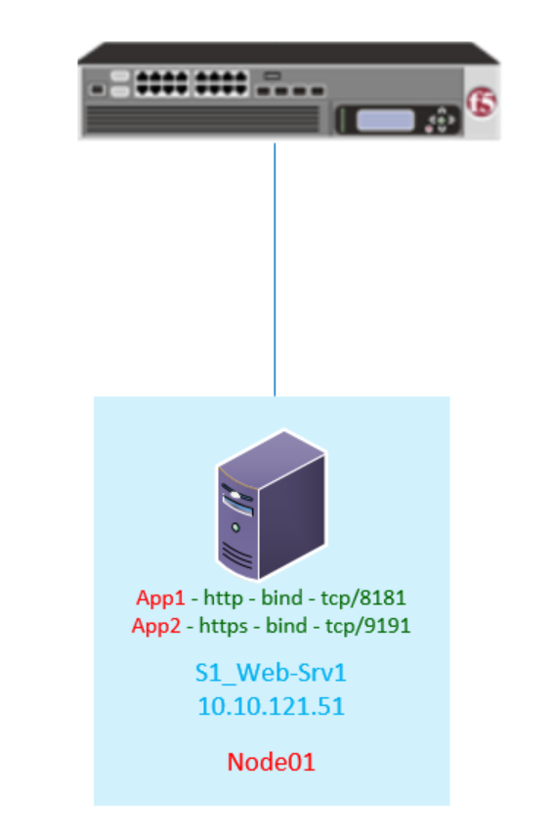
Step 03: Health Monitors
(Other Health Monitors – TCP/UDP port monitor)
To monitor ports listening on the server, F5 uses TCP or UDP health monitors.

Slide 16
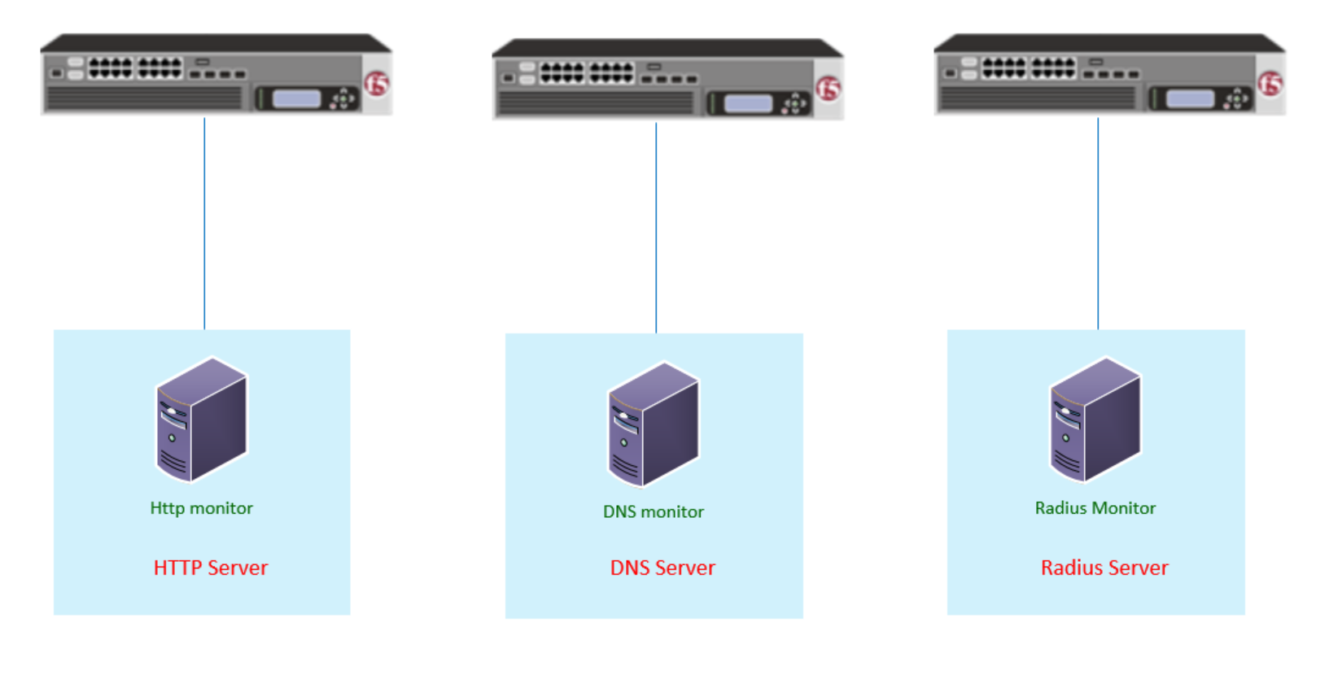
Step 03: Health Monitors
(Other Health Monitors – Application specific monitor)
To monitor applications, F5 uses application-specific health monitors such as HTTP, DNS, or RADIUS.

Slide 17
This concludes Chapter 05. I hope this video helped you understand the concepts of Nodes, Pools, Pool Members and Health Monitors. Continue with Chapter 06 to configure the Nodes, Pools, Pool Members and Health Monitors. Thank you for watching!
Chapter 05 – Understand the concepts of Nodes, Pools, Pool Members and Health Monitors

